Slide 1
CS 673: Fall 2017
Video Collaboration Feature for 3Blueprints
Team 4
Iteration 0

Slide 2
Peer-to-Peer Video Collaboration Feature
An enhancement to the communication application in 3Blueprints
Why?
Distributed teams are becoming the norm
Text chat applications are not enough for effective communication among these teams
Peer-to-Peer is a minimum requirement in a collaboration tool like 3Blueprints
Competitors?
Slack
Skype
Hipchat/Stride
How are we different?
Integration with a suite of software engineering tools
Possibility for direct linkage to defect and requirement management portions of 3Blueprints
Notes:
Our project is to add video chat functionality to the existing 3Blueprints communication application. In the process, we’ll be improving documentation for end-users and administrators alike, increasing test coverage, restructuring the logical organization of the project, and adding automated deployments.

Slide 3
Requirements
Functional requirements
Non Functional Requirements
Essential Features
Desirable Features
Optional Features
Notes:
We’ve split the requirements into functional and nonfunctional requirements, which we will review in the next couple of slides. Functional requirements are broken down into essential, desirable, and optional features.

Slide 4
Essential Features
Peer-to-Peer video chat embedded into the existing application
Browser embedded audio and video
Multi-platform, multi-browser support
Clean integration with existing chat application
Switch between video and screen sharing

Slide 5
Desirable Features
File sharing option between individual users
Individual user file storage
Shared file storage
Integration with Google Drive
Support for file transfer interruption
2. Video Chat:
HD video
Group or conference video chat

Slide 6




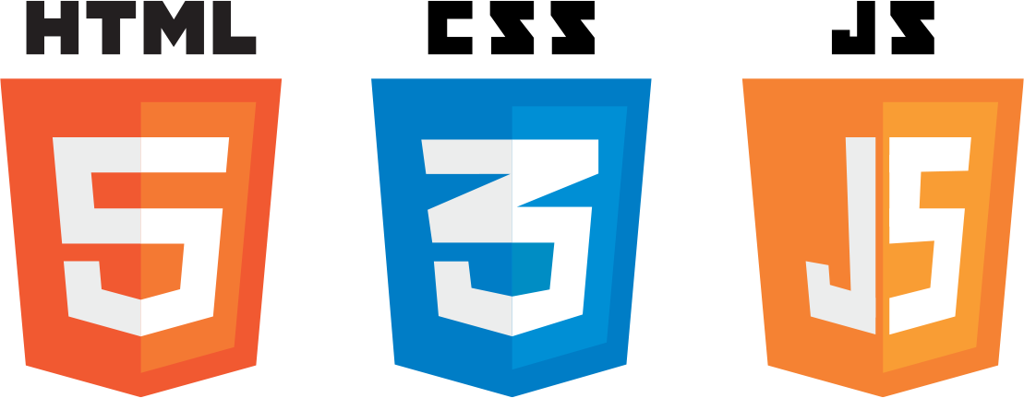

Tools and technology
Version Control: GitHub
Communication: Slack
Requirements analysis: Pivotal Tracker
Deployments: Docker
Frontend: Javascript, HTML5, CSS3
Backend: Django framework (Python, SQLite3)
Notes:
Dan B

Slide 7
Configuration Management and Deployment
Github for source control:
Approval required for PR to Master and Development Branches
Master, Development and Feature Branches
Docker for repeatable deployments:
Each branch and release will have it’s own stable docker
Docker builds tracked and tested for each branch
Enables fast and painless deployments
Implemented improvements:
Packed 3Blueprints into a working Docker image
Set up automated Docker image builds triggered by changes to repository
Set up github integration with slack, notifications on commit, PR and merge
Notes:
Dan B

Slide 8
Quality Management
Quality Assurance Plan
Throughout the entire software development life cycle
Applying Capability Maturity Model (CMM)
Matrix : Products & Process
Standards : Coding & Documentation
Inspection/Review Process
Testing
Defect Management
Level 5: Optimizing
Focus on process improvement
Level 4: Quantitatively Managed
Processes measured and controlled
Level 3: Defined
Processes characterized for organization, Proactive
Level 2: Managed
Processes characterized for projects, reactive.
Level1: Initial
Processes unpredictable, poorly controlled and reactive

Slide 9
Where do we go from here?
We’ve all got a lot of work to do, getting up to speed on Django, Javascript, and various tools
After class we will be meeting as a team and reviewing the configuration management tools
Continue our weekly meetings, which started last week on Sunday
Ensure that everyone is able to get the existing application up and running, and able to execute test cases

Slide 10
Conclusion

